Slide 1
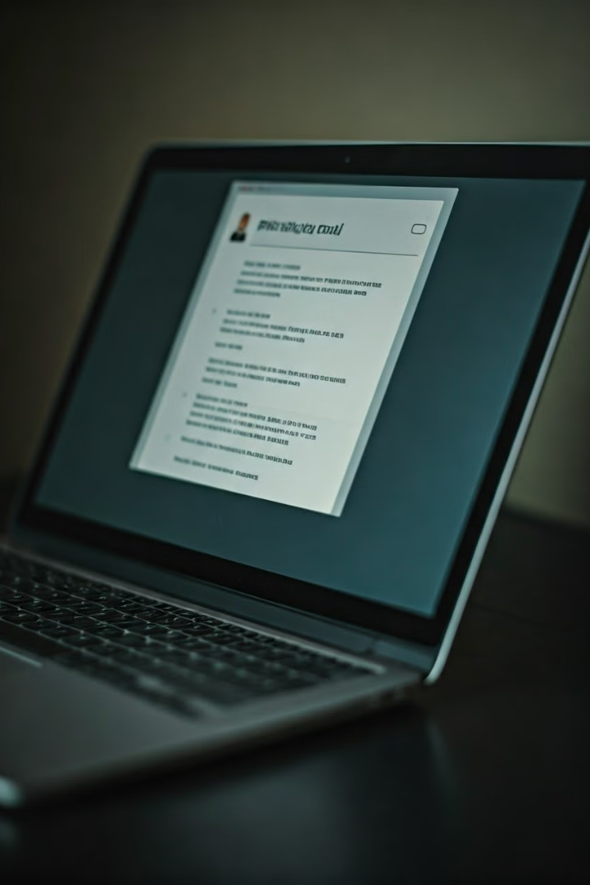

Understanding phishing attacks
Phishing is a type of cyber attack where criminals tries to trick individuals into revealing sensitive information, such as usernames, passwords, credit card numbers, or other personal details. or taking actions that compromise your security. It's crucial to be able to recognize and avoid these sophisticated scams.

Slide 2
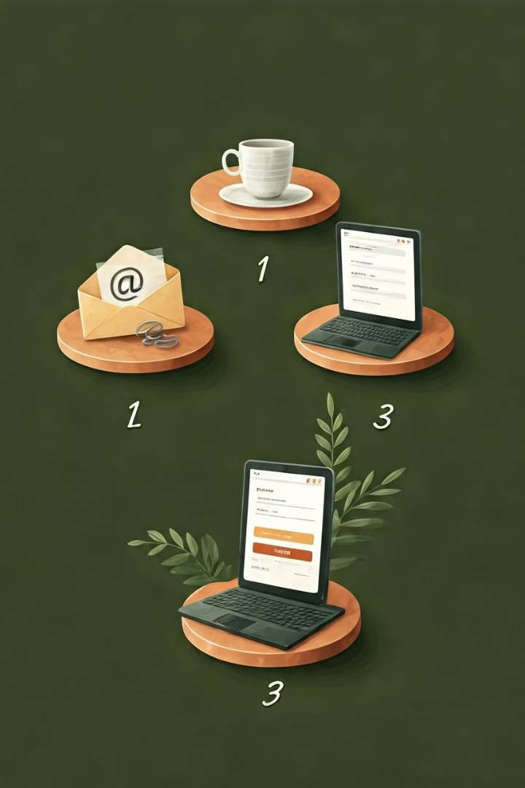
Anatomy of a phishing attack
Lure - A convincing bait is created, often mimicking legitimate sources, such as banks or popular online services, to establish trust.
Spoofing-Attackers employ spoofed email addresses or websites that closely resemble legitimate entities to gain trust and instill a sense of urgency.
Steal Credentials - The target receives the email and, believing it to be legitimate, clicks on the link or opens the attachment.
Exploit Access - Attackers use the captured information for various malicious purposes, such as identity theft, financial fraud, or unauthorized access to accounts.

Slide 3
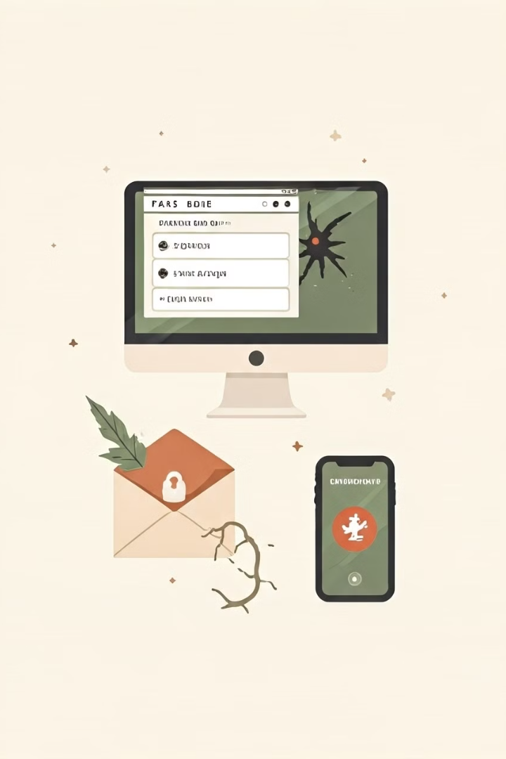
Common Phishing Tactics
Fake login pages –Phishers create replicas of legitimate websites to steal your login credentials
Malicious Attachments - Phishing emails may contain malware-infected files that compromise your device
Urgent Calls to Action- Phishers create a false sense of urgency to pressure you into clicking or sharing info
Spoofed Sender Addresses - Phishers disguise their identities by using email addresses that look legitimate.

Slide 4
Spotting Visual Cues
1. Email Address
Check the Sender: Look closely at the sender's email address. Phishing emails often come from addresses
that look similar to legitimate ones but may have slight variations or misspellings.
2. URLs and Links
Hover Over Links: Before clicking on any link, hover over it to see the actual URL. Be cautious of URLs that
look suspicious or unfamiliar.
3. Spelling and Grammar
Look for Errors: Phishing emails often contain spelling and grammar mistakes. Legitimate organizations
usually have professional communication standards.
4. Urgent or Threatening Language
Be Skeptical of Urgency: Phishing emails often create a sense of urgency or fear to prompt immediate action
without thinking.
."

Slide 5

Evaluating Website Legitimacy
HTTPS & SSL
Ensure the website uses HTTPS and has a valid SSL/TLS certificate.
Trust Seals
Legitimate sites often display trust seals from reputable security providers
Who is Lookup
Check the website's registration details to verify its owner and purpose.
Contact Information
Legitimate businesses provide clear contact details, including a physical address

Slide 6
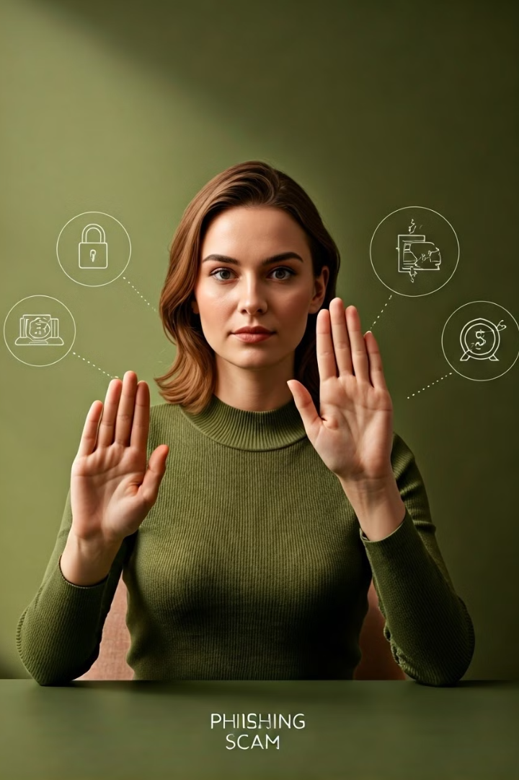
Defending Against Social Engineering
Stay Vigilant
Be aware of attempts to exploit your trust or emotions
Stay Vigilant
Verify the legitimacy of any unusual or suspicious requests
Protect Yourself
Use security best practices to safeguard your information
Report Incidents
Notify the appropriate authorities about phishing attempts

Slide 7

Handling Suspicious Emails
1
Verify the Sender
Check the email address to ensure it's from a legitimate source.
2
Inspect for Red Flags
Look for signs of phishing, like poor grammar, strange links, or urgent requests.
3
Delete Suspicious Emails
If in doubt, the safest option is to delete the email and block the sender.

Slide 8
Handling Suspicious Emails
4
6
Enable multi factor authentication
MFA can prevent unauthorized access by requiring a second form of verification
Reports the Emails
Many email client have a built in tools to report phishing emails
5
Keep software update
Operating system,email client, security software are up to date

Slide 9
Leveraging Multi-Factor Authentication
Stronger Security
Multi-factor authentication adds an extra layer of protection beyond just a password.
Supported Methods
Common MFA options include SMS, authenticator apps, biometrics, and security keys
Recommended Practice
Enable MFA wherever possible to safeguard your accounts from unauthorized access

Slide 10
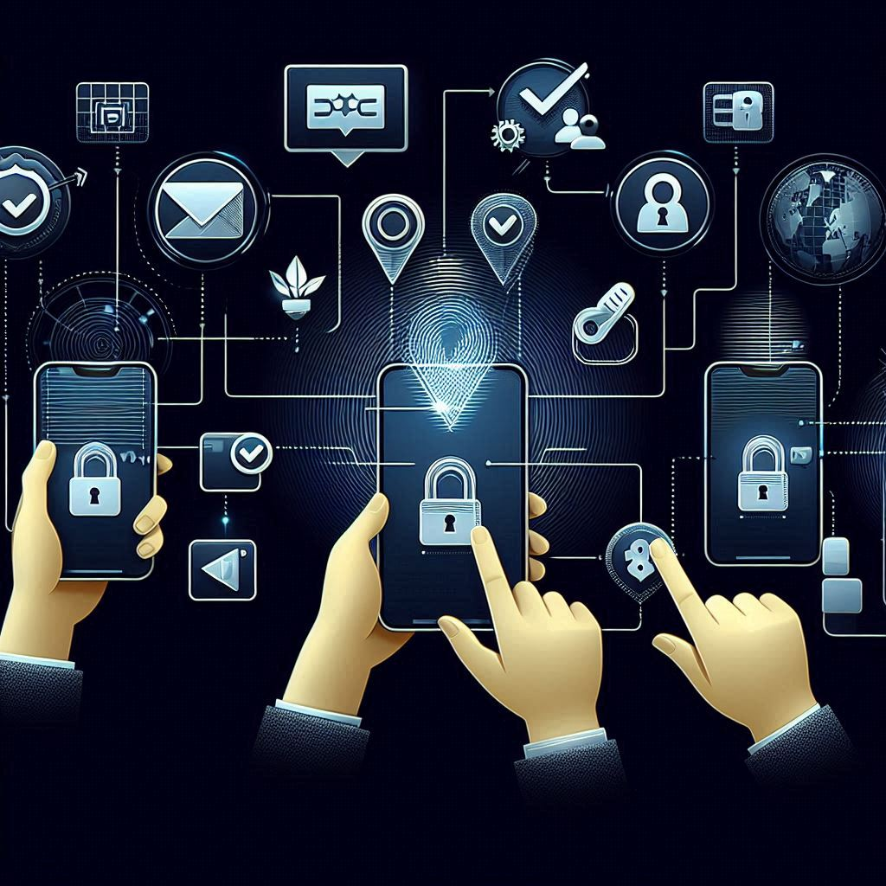
How MFA Works
User Login: The user enters their username and password.
Second Factor: The system prompts the user for a second form of verification, such as:
One-Time Password (OTP): Sent via SMS, email, or generated by an authenticator app.
Security Token: A physical device that generates a code.
Biometric Verification: Fingerprint, facial recognition, or voice recognition.
Access Granted: Once the second factor is verified, the user is granted access.

Slide 11
Scenario: Protecting Against Phishing in an Online Banking System
1. User Login
Step 1: The user navigates to the online banking login page.
Step 2: The user enters their username and password.
2. Second Factor Verification
Step 3: After entering the correct username and password, the system prompts the user for a second form of verification.
Step 4: The user receives a One-Time Password (OTP) on their registered mobile phone via SMS or through an authenticator app.
Step 5: The user enters the OTP into the login page.
3. Access Granted
Step 6: Once the OTP is verified, the user is granted access to their online banking account.

Slide 12

How MFA Protects Against Phishing
Phishing Attempt: An attacker sends a phishing email that tricks the user into providing their username and password on a fake website.
MFA Barrier: Even if the attacker obtains the username and password, they cannot access the account without the second factor (OTP).
Failed Access: The attacker is unable to receive the OTP, preventing unauthorized access to the account
Notification of Login Attempts: Many MFA systems send real-time alerts to users when a login attempt is made. If a user receives an alert for an unrecognized login attempt, they can take immediate action to secure their account.

Slide 13
Benefits of MFA in Preventing Phishing
Enhances Security for High-Value Transactions
Transaction Verification: MFA can be used to verify high-value transactions, adding an extra layer of security for sensitive operations.
Approval Process: Users may need to approve transactions through a second factor, such as a push notification or biometric verification.
Protects Against Credential Stuffing
Credential Stuffing: Attackers use stolen credentials from one breach to try and access other accounts. MFA mitigates this risk by requiring a second factor.
Reduced Success Rate: Even if attackers have valid credentials, they cannot access accounts without the second factor.

Slide 14
Benefits of MFA in Preventing Phishing
Supports Zero Trust Security Model
Zero Trust: MFA aligns with the Zero Trust security model, which assumes that no user or device is trusted by default.
Continuous Verification: MFA ensures continuous verification of user identity, reducing the risk of unauthorized access.
Increases User Accountability
Audit Trails: MFA provides detailed audit trails of login attempts and access, increasing user accountability.
Traceability: Any suspicious activity can be traced back to the specific user, helping to identify potential security breaches.

Slide 15

Conclusion and Call to Action
Protecting yourself from phishing attacks requires vigilance, critical thinking, and a commitment to security best practices. Stay informed, be cautious, and empower yourself and your organization to combat these persistent threats.

